Slide 1


Lightweight Pneumothorax Segmentation with an Optimized U-Net and EfficientNet-B0 for X-Ray Analysis
Thesis Proposal Defense
Examiner:
Dr. Mardhani Riasetiawan, SE Ak, M.T
Novera Istiqomah, S.T., M.T., Ph.D.
Lecturer Advisor:
Wahyono, S.Kom., Ph.D.
Michael Satpelin Williamtu (23/517103/PA/22151)
www.ugm.ac.id
Locally Rooted, Globally Respected
Notes:
Good morning/afternoon, Bapak/Ibu dosen penguji and Bapak Wahyono. My name is Michael Satpelin Williamtu, and today I'll be presenting my bachelor thesis proposal titled "Lightweight Pneumothorax Segmentation with an Optimized U-Net and EfficientNet-B0 for X-Ray Analysis."

Slide 2
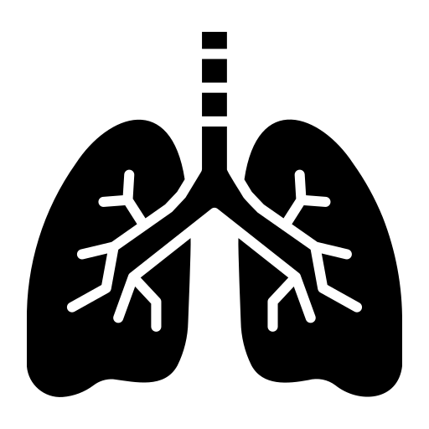


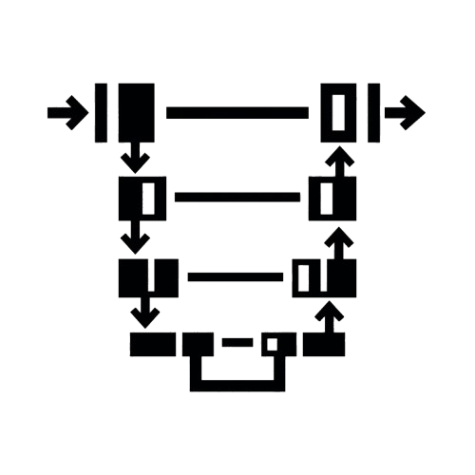

Presentation Outline
1
2
3
4
5
What is pneumothorax and why does it matter clinically?
Limitations of current AI approaches
State-of-the-art CXR segmentation methods
Dataset, architecture, training pipeline
Evaluation Metrics
Background
Research
Problem
Literature
Review
Methodology
Evaluation
Notes:
I'll walk through five parts today: first, the clinical background of pneumothorax; second, the research problem with existing AI approaches; third, a brief literature review; fourth, my proposed methodology; and finally, the evaluation strategy.

Slide 3
Background

Slide 4
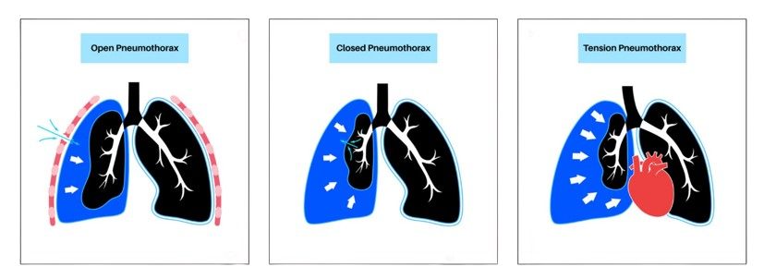



What is Pneumothorax?
The Condition
Air trapped in the pleural space
partial or complete lung collapse
Can escalate to tension pneumothorax a life-threatening emergency
20%
of cases MISSED during standard exams
Chest X-ray (CXR) is the primary diagnostic tool
ACR mandates urgent communication within minutes of suspicion
#1
Chest X-ray (CXR) is the diagnostic tool
2D projection of 3D anatomy
Overlapping Structures
Notes:
Pneumothorax is a condition where air becomes trapped in the pleural space — the thin gap between the lung and the chest wall. This air pushes against the lung, causing it to partially or fully collapse.
There are different types — as shown here, open, closed, and tension pneumothorax. Tension pneumothorax is especially dangerous because it can rapidly become life-threatening, requiring emergency intervention.
Chest X-ray, or CXR, is the number one diagnostic tool used to detect this condition. However, diagnosing it from a CXR is genuinely difficult. A chest X-ray is a 2D projection of a 3D body, so organs and bones overlap on the image. Because of this, studies show that up to 20% of pneumothorax cases are missed during standard examination — even by trained radiologists.

Slide 5
Research Problem

Slide 6
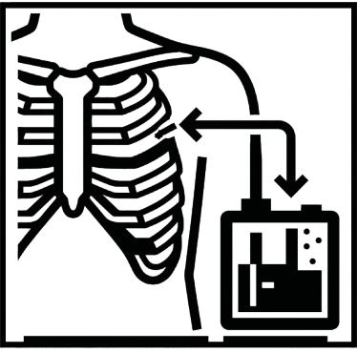



Why Existing AI Approaches Fall Short?
Hidden Stratification
SIIM-ACR Dataset
Extreme Class Imbalance
Classification models learn false shortcuts
Chest Tube
Positive
22%
of images have pneumothorax
Standard loss functions (BCE) learn to predict background everywhere
Inflates fake validation accuracy and
fails on untreated patients
<2%
pneumothorax
lesion pixels
Low-Contrast Boundaries
Heavy Computational Cost
Pleural air interface
Superimposed ribs and vessel shadows
State-of-the-art models
require massive GPU resources
subtle, low-gradient transition, not a sharp edge
extremely hard for a model to learn the correct decision boundary.
TGAPneumoSeg, ATRC-Net, ViT-based architectures
not available in standard clinical settings
Notes:
There are four major issues with existing approaches.
First, hidden stratification. Classification models — models that just say "pneumothorax: yes or no" — often learn the wrong pattern. For example, they learn to associate the presence of a chest tube with a positive pneumothorax label, because chest tubes are inserted to treat pneumothorax. So the model isn't actually learning to detect the disease — it's learning to detect medical equipment. This inflates a fake validation accuracy but the model fails completely on untreated patients who don't have a chest tube yet — which are exactly the patients we most need to help.
Second, extreme class imbalance. In the SIIM-ACR dataset, only 22% of images even have pneumothorax. And within those positive images, the lesion itself takes up less than 2% of the pixels. If you train with a standard loss function like Binary Cross Entropy, the model learns that predicting "background" everywhere gives a very low loss — so it just... does that. It learns nothing.
Third, low-contrast boundaries. The edge between the collapsed lung and the trapped air is a subtle, low-gradient transition — not a sharp line. On top of that, superimposed ribs and blood vessel shadows overlap with this boundary, making it extremely hard for a model to learn the correct decision boundary.
Fourth, heavy computational cost. The current best-performing models — like TGAPneumoSeg or ATRC-Net — use transformers or GAN-based(Generative Adversarial Network) architectures that require massive GPU resources, which most hospitals simply don't have.

Slide 7
What This Study Aims to Achieve
1
Develop a U-Net semantic segmentation model with EfficientNet-B0 encoder, optimized for subtle low-contrast pneumothorax boundaries in the SIIM-ACR dataset.
2
Solve extreme pixel-level class imbalance by integrating CLAHE preprocessing and a Focal Tversky Loss function into the training pipeline.
3
Measure segmentation accuracy using Dice Score and Intersection over Union (IoU), metrics that correctly evaluate lesion localization, not inflated by background pixels.
Notes:
Based on these problems, I defined three objectives.
One, develop a U-Net segmentation model with an EfficientNet-B0 encoder, specifically optimized to detect these subtle, low-contrast pneumothorax boundaries.
Two, solve the extreme pixel-level class imbalance by combining CLAHE (Contrast Limited Adaptive Histogram Equalization) preprocessing with a Focal Tversky Loss function in the training pipeline.
Three, measure performance using Dice Score and IoU — metrics that actually reflect lesion-localization quality, instead of being inflated by correctly predicting background pixels.

Slide 8
Literature Review

Slide 9
Architecture Evolution in CXR Segmentation
Classical
Thresholding
Watershed
PCA-LDA
Early DL
U-Net
Attention U-Net
U-Net++
Advanced
GAN (Pix2Pix)
Transformer
Multi-task
Key SOTA Comparison
Model | Target | Dice/mDice | IoU/mIoU | Complexity
TGAPneumoSeg (Mann et al., 2025) | Pneumothorax | 0.8394 | 0.8198 | Very High
ATRC-Net (Karuppusamy, 2025) | Multi-pathology | 0.92 | 0.85 (Jaccard) | Very High
U-Net + EfficientNet-B0 (Lin et al., 2025) | Pneumothorax | 0.30 (mDice) | 0.20 (mIoU) | Low
Notes:
CXR segmentation has evolved from classical image-processing methods like thresholding and watershed, to early deep learning models like U-Net and its variants, to today's advanced architectures using GANs, transformers, and multi-task learning.
Looking at the SOTA comparison table: TGAPneumoSeg and ATRC-Net achieve very high Dice and IoU scores — around 0.83 to 0.92 — but at "Very High" architectural complexity.
The most relevant reference for my work is Lin et al. (2025), who used the exact same architecture I'm proposing — U-Net with EfficientNet-B0 — but with a basic training pipeline. Their result was only 0.30 mDice and 0.20 mIoU.
My hypothesis is: the architecture itself isn't the bottleneck — the training pipeline is. So my contribution is to keep this lightweight architecture, but build a significantly more optimized pipeline around it

Slide 10
Methodology

Slide 11
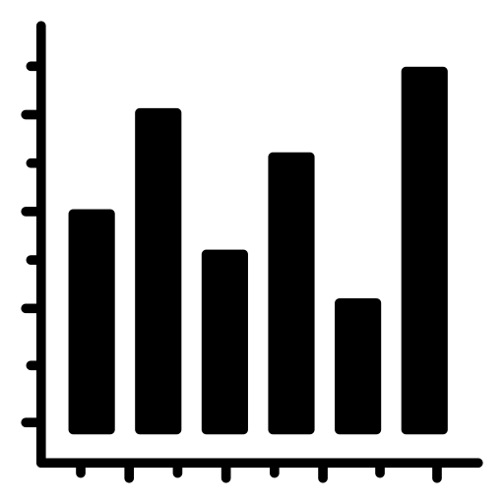



End-to-End Pipeline Overview
1
2
3
4
5
6
Input Data
Preprocessing
Model
Training
Post-Process
Evaluation
SIIM-ACR
12,047 DICOM
chest X-rays
Resize 512×512
CLAHE
Normalize + Aug
U-Net Decoder
+ EfficientNet-B0 Encoder
Focal Tversky
Loss + BCE
Cosine Annealing
Thresholding
TTA
Morphological
Dice Score
+ IoU
(Positive cases)
Notes:
The full pipeline has six stages. Starting with the SIIM-ACR dataset of 12,047 DICOM chest X-rays. These go through preprocessing — resizing to 512×512, applying CLAHE, normalization, and augmentation. Then they're fed into the U-Net decoder with the EfficientNet-B0 encoder. Training uses Focal Tversky Loss combined with BCE, and a Cosine Annealing learning rate schedule. After training, post-processing applies thresholding, test-time augmentation, and morphological filtering. Finally, we evaluate using Dice Score and IoU on positive cases only.
Every stage in this pipeline directly targets one of the two core challenges I mentioned earlier — class imbalance, or low contrast. I'll go through the key stages now.

Slide 12
SIIM-ACR Pneumothorax Segmentation Dataset
12,047
Training images (DICOM)
3,205
Test Images
Why this dataset?
Industry-standard benchmark (Kaggle 2019 SIIM-ACR challenge)
Verified pixel-level expert annotations (no ambiguous masks)
Resolves hidden stratification issues better than classification datasets
22%
Positive (pneumothorax) cases
1:50+
Foreground : background pixel ratio
Used by both key references: Lin et al. (2025) and Mann et al. (2025)
Publicly available, fully reproducible results
Notes:
The dataset is the SIIM-ACR Pneumothorax Segmentation dataset from the 2019 Kaggle challenge — 12,047 training images and 3,205 test images, all DICOM format with pixel-level expert annotations.
As mentioned, only 22% of images are positive, and the foreground-to-background pixel ratio can be as extreme as 1:50 or worse.
I chose this dataset for five reasons: it's an industry-standard benchmark, it has verified pixel-level annotations with no ambiguity, it directly resolves the hidden stratification problem better than classification datasets, it's used by both of my key references — Lin et al. and Mann et al. — and it's publicly available, so my results are fully reproducible.

Slide 13
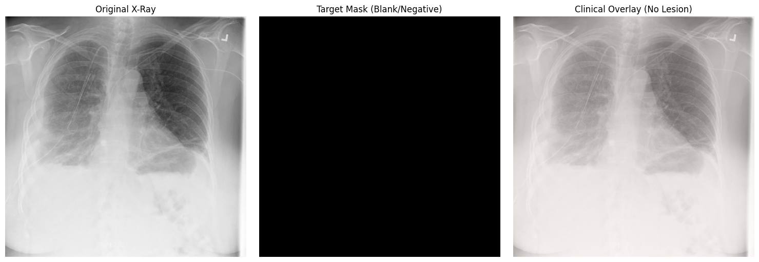
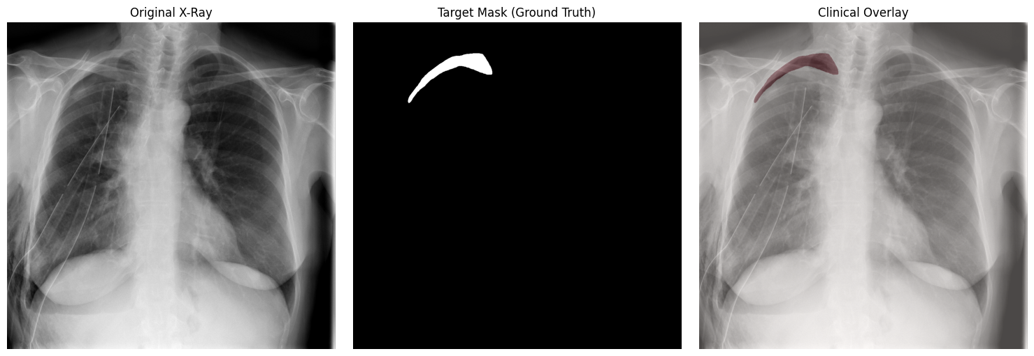
SIIM-ACR Pneumothorax Segmentation Dataset
Negative
Positive

Slide 14
U-Net + EfficientNet-B0 Architecture
ENCODER
EfficientNet-B0
1x1 conv
+ sigmoid
DECODER U-Net
Why EfficientNet-B0?
Output Mask 512×512×1
Strided 3x3 conv
~5.3M parameters (smallest EfficientNet)
Compound scaling of depth, width & resolution
MBConv blocks
depthwise separable convolutions
ImageNet pretrained faster convergence
5 feature levels → 5 skip connections
Input 512×512×3
UpConv Block 1 512×512×16
transpos
e
conv
MBConv Block 1 256×256×16
UpConv Block 2 256×256×32
Strided
conv
Skip Connections
MBConv Block 2 128×128×24
UpConv Block 3 128×128×64
MBConv Block 3 64×64×40
UpConv Block 4 64×64×128
MBConv Block 4 32×32×112
UpConv Block 5 32×32×256
Bottleneck 16×16×320
Transposed Conv 32×32×256
Transpose conv
Notes:
This diagram shows the full architecture. On the left is the encoder — EfficientNet-B0 — which progressively downsamples the input image from 512×512 down to a 16×16 bottleneck, extracting increasingly abstract features. On the right is the U-Net decoder, which upsamples back to a full 512×512 segmentation mask. The dashed lines are skip connections, linking each encoder level to its corresponding decoder level.
Why EfficientNet-B0 specifically? it's the smallest model in the EfficientNet family, at only about 5.3 million parameters. It uses compound scaling — balancing network depth, width, and resolution together rather than scaling one dimension at a time. Its building blocks, called MBConv blocks, use depthwise separable convolutions, which are computationally cheap but still expressive. It's pretrained on ImageNet, so it converges faster even with our limited number of positive training samples. And it naturally provides 5 feature levels, which map perfectly onto U-Net's 5 skip connections.

Slide 15
U-Net + EfficientNet-B0 Architecture
ENCODER
EfficientNet-B0
1x1 conv
+ sigmoid
DECODER U-Net
Why U-Net?
Output Mask 512×512×1
Strided 3x3 conv
Medical standard
Proven architecture for biomedical semantic segmentation
Skip connections
Bridges early high-res features directly to decoder
Spatial precision
Recovers exact pixel positions lost during downsampling
Critical for pneumothorax Accurately captures thin, irregular pleural air pockets
Input 512×512×3
UpConv Block 1 512×512×16
transpos
e
conv
MBConv Block 1 256×256×16
UpConv Block 2 256×256×32
Strided
conv
Skip Connections
MBConv Block 2 128×128×24
UpConv Block 3 128×128×64
MBConv Block 3 64×64×40
UpConv Block 4 64×64×128
MBConv Block 4 32×32×112
UpConv Block 5 32×32×256
Bottleneck 16×16×320
Transposed Conv 32×32×256
Transpose conv
Notes:
On the decoder side — why U-Net specifically? U-Net is the medical imaging standard, proven for biomedical segmentation since 2015. Its defining feature is the skip connections, which bridge high-resolution encoder features directly to the decoder — this is what gives the model spatial precision, recovering exact pixel positions that would otherwise be lost during downsampling.
This is especially critical for pneumothorax, because the pleural air pocket is thin and irregularly shaped — without those skip connections, the model would lose the fine boundary details needed to trace its exact outline.

Slide 16
Tackling Class Imbalance
Why U-Net?
Focal Tversky Loss (FTL)
Cosine Annealing
with Warm Restarts
BCE Loss : equal weight per pixel → dominated by 98% background → predicts background everywhere
Adam optimizer is stable with sparse gradients
LR cycles from ηmax → ~0 (cosine curve)
Warm restart resets LR to ηmax each cycle
Escapes shallow local minima in imbalanced loss landscape
Finds flatter, more generalizable minima
Dice Loss : better but weighs FP = FN equally. Clinically, False Negatives (missed lesion) are more dangerous.
Focal Tversky (α=0.7, β=0.3, γ=4/3) : 70% penalty on FN (missed lesions). Upweights hard-to-classify small regions via γ.
Final Loss = λ · FTL + (1-λ) · BCE
Notes:
This is the core of my optimization strategy — the loss function.
Standard BCE loss gives equal weight to every pixel. Since 98% of pixels are background, the loss is dominated by background, and the model learns to predict background everywhere.
Dice Loss is better — it directly measures overlap — but it weighs False Positives and False Negatives equally. Clinically, that's the wrong trade-off: a missed lesion, a False Negative, is far more dangerous than a False Positive.
So I use Focal Tversky Loss, with alpha equals 0.7 and beta equals 0.3 — meaning 70% of the imbalance penalty falls on missed lesions. The gamma parameter, set to 4 over 3, additionally upweights hard-to-classify small regions. The final loss combines this with BCE for training stability.
On the right — for the optimizer, I use Adam combined with Cosine Annealing with Warm Restarts. The learning rate cycles from a maximum value down to near zero following a cosine curve, then resets. This helps the optimizer escape shallow local minima that are common in this highly imbalanced loss landscape, and tends to converge to flatter, more generalizable minima.

Slide 17
CLAHE: Making Low-Contrast Boundaries Visible
Raw X-Ray
(low contrast
boundary)
Divide into
local tiles
(grid)
Clip histogram
at CL threshold
(limit noise)
Cumulative
H-Map per tile
(local contrast)
Bilinear
interpolation
between tiles
Enhanced X-Ray
(clear boundary
& amplified edge)
Why CLAHE is Particularly Effective for Pneumothorax
Local Adaptivity
The pleural boundary exists in a limited spatial region with a narrow intensity range. Local tile-based enhancement amplifies this region without being dominated by the surrounding background statistics.
Clip Limit (CL)
Prevents over-amplification of noise that would confuse the encoder, it balances contrast enhancement with noise control.
Better Gradients
Sharper boundaries → richer gradient signals for EfficientNet-B0 early layers → faster convergence on lesion features during training.
Notes:
The second optimization targets the low-contrast boundary problem, using CLAHE — Contrast Limited Adaptive Histogram Equalization.
The pipeline works like this: the raw X-ray is divided into local tiles. Each tile's histogram is clipped at a threshold to limit noise amplification. A cumulative histogram map is computed per tile to enhance local contrast. Then bilinear interpolation blends neighboring tiles together smoothly. The result is an enhanced X-ray with a much clearer, amplified lesion boundary.
Why is this particularly effective for pneumothorax? Three reasons. Local adaptivity — the pleural boundary occupies a small spatial region with a narrow intensity range, so local tile-based enhancement amplifies exactly that region without being washed out by the much larger background. The clip limit prevents the noise amplification that would otherwise confuse the encoder. And the result is better gradients — sharper boundaries give the EfficientNet-B0 encoder richer gradient signals in its early layers, leading to faster convergence on lesion features during training.

Slide 18
Evaluation

Slide 19
Metrics: Why Dice Score & IoU?
Why not pixel accuracy?
In SIIM-ACR, background = 95-99% of pixels. A model predicting 100% background (detecting nothing) scores 95-99% accuracy, which means completely misleading. Overlap-based metrics expose this failure.
Intersection over Union (IoU)
Dice Similarity Coefficient
IoU = TP / (TP + FP + FN)
Dice = 2TP / (2TP + FP + FN)
Measures overlap ratio of predicted vs. ground truth masks
1.0 = perfect, 0.0 = no overlap
Strict: FP and FN independently reduce score
Also called the Jaccard Index
Harmonic mean of precision and recall at pixel level
Less sensitive to very small lesions than IoU
Dice = 0.30 means predicted and truth overlap 30% of their average size
Standard metric in medical image segmentation research
Notes:
Why not just use pixel accuracy? Because in SIIM-ACR, background makes up 95 to 99% of all pixels. A model that predicts "background everywhere" — detecting nothing at all — would still score 95 to 99% accuracy. That number would be completely misleading.
Instead, I use two overlap-based metrics. Intersection over Union, or IoU, is the ratio of true positives over the union of predicted and ground truth masks — it's strict, because both false positives and false negatives independently reduce the score. A score of 1.0 means a perfect match.
Dice Similarity Coefficient is the harmonic mean of precision and recall at the pixel level — slightly more forgiving for very small lesions. A Dice score of 0.30, for example, means the predicted and ground truth masks overlap by 30% of their average size.
Both metrics are computed only on positive test images and averaged — so the score directly reflects how well the model finds the actual lesion, not how well it ignores the background. This gives a direct, apples-to-apples comparison with the baseline from Lin et al. (2025), which achieved 0.30 mDice and 0.20 mIoU.

Slide 20
Thank You

Slide 21
Appendix : The Clinical Problem & Dataset
Hidden Stratification: * The Trap: Standard classification models act as lazy "chest tube detectors," leading to 100% false negatives on untreated patients.
The Fix: SIIM-ACR provides pixel-level masks that only highlight the air. The model is physically forced to learn the true morphology (shape) of the lung, completely solving this trap.
"Predict Background Everywhere":
The Trap: Because the background makes up 98% of the image, BCE loss allows the model to output a completely blank black mask and still score 98% accuracy, while missing every single lesion.
Why these 3 Papers for the Literature Review?
Lin et al. (2025): The direct baseline (same architecture, unoptimized pipeline = 0.30 Dice).
Mann et al. (2025): The SOTA benchmark (high score but heavy/complex).
Karuppusamy (2025): The industry trend (hyper-complex, massive hardware).
The Argument: Proves we need an architecture that is lightweight like Lin's, but optimized to rival the big models.
Notes:
Theoretical Benefits then Practical Benefits

Slide 22
Appendix : The Clinical Problem & Dataset
Standard Benchmark Split - strictly follows the Kaggle 2019 SIIM-ACR challenge framework
Training Set - 12,047 images used for model optimization
Test Set - 3,205 images reserved purely for evaluation (~79% / 21% split)
Real-World Class Imbalance - test set preserves the natural 22% positive rate (~705 pneumothorax cases vs. ~2,500 healthy cases)
Notes:
Theoretical Benefits then Practical Benefits

Slide 23
Appendix : The Architecture
5.3M Parameters: The absolute smallest model. Guarantees it can run on standard hospital PCs, not massive GPU servers.
Compound Scaling: Instead of blindly adding layers, EfficientNet mathematically balances depth, width, and resolution simultaneously for maximum efficiency.
Depthwise Separable Convolutions (MBConv):
Standard Conv: Mixes spatial info (shapes/where) and channel info (features/what) at the same time = requires massive FLOPs (math/computations).
Depthwise Separable: Splits them. Looks at shapes first, mixes channels second. Drastically cuts FLOPs.
Skip Connections (Solving Downsampling Amnesia):
The Trap: The encoder shrinks the image to 16x16. The model knows what the lesion is, but forgets where the exact pixel boundaries are.
The Fix: Skip connections act as bridges, copying high-resolution maps directly to the decoder so it can perfectly trace the thin, irregular pleural air pocket.
Notes:
Theoretical Benefits then Practical Benefits

Slide 24
Appendix : Loss & Optimizer
Focal Tversky Loss (FTL) Parameters:
α = 0.7, β =0.3: Places a 70% penalty on False Negatives (misses) and 30% on False Positives (false alarms). Clinically safer. (Based on Abraham & Khan, 2018).
γ =4/3 : Acts as a magnifying glass. Since γ= 0.75, the math naturally shrinks the loss for easy background pixels and keeps the loss massive for hard, tiny boundary pixels.
Final Loss Formula: λ · FTL + (1-λ) · BCE. BCE provides stable, smooth gradients early in training; FTL takes over to handle the extreme class imbalance later.
Adam vs. SGD (Sparse Gradients):
Sparse Gradients: Lesion pixels are so rare (2%) that their specific detectors are almost never updated.
The Fix: SGD uses one global learning rate and would let the background dominate. Adam gives every single parameter its own step size. It shrinks the steps for the frequent background and preserves large, confident steps for the rare lesion updates.
Notes:
"Our loss function is a hybrid approach. The core component is the Focal Tversky Loss, originally proposed by Abraham and Khan in 2019 specifically for imbalanced medical segmentation. We use their recommended parameters, weighing false negatives at 70%, because missing a lesion is clinically dangerous. We combine this with standard Binary Cross-Entropy, which stabilizes the pixel-level gradients during the early stages of training."

Slide 25
Appendix : Cosine Annealing
The Cosine Wave: The learning rate smoothly decays on a curve, giving the optimizer millions of tiny, careful micro-steps at the bottom to perfectly fine-tune the lesion boundary.
Warm Restarts: Instantly resets the learning rate to maximum ηmax like a jetpack.
Local vs. Global Minima: The jetpack blasts the model out of shallow "local minima" (e.g., getting stuck at 90% accuracy) so it can bounce over the bumpy terrain and settle into a wide, flat "global minimum." Flat minima are highly generalizable, meaning the AI won't break on a new patient's X-ray.
Notes:
Theoretical Benefits then Practical Benefits

Slide 26
Appendix : CLAHE Preprocessing
The AHE Trap (Invisible Grain): Standard AHE forces every area to have maximum contrast. It takes microscopic, invisible X-ray sensor static and stretches it across the color spectrum, amplifying it into blinding visual noise.
Clip Limit (CL): Limits the count/frequency (not brightness) of identical pixels. It chops the top off massive spikes of identical static pixels, acting as a ceiling to prevent noise amplification.
Tiling & H-Map: Cuts the X-ray into a chessboard. The H-Map is the specific "stretching rule" that optimally stretches the dark/light pixels for that specific square, highlighting the lesion locally.
Bilinear Interpolation: Smoothly blends the H-Maps of neighboring squares together, completely erasing the artificial grid lines from the final image.
Notes:
Theoretical Benefits then Practical Benefits

Slide 27
Appendix : Post-Processing & Evaluation
Test Time Augmentation (TTA): Flips the test image horizontally and averages the two predictions. The AI's "second opinion" to reduce variance.
Thresholding (0.5): Converts the U-Net's "probability map" into a hard, definitive Yes/No (Black/White) binary mask.
Morphological Filtering: "Dusts off the crumbs." Deletes microscopic, disconnected white specks (false alarms) because pneumothorax is a collected air pocket, not scattered dots.
TP, FP, TN, FN (Pixel Level):
TP: Hit. FP: False Alarm. FN: Miss (The worst error). TN: Correctly ignored background (98% of the image).
Notes:
Theoretical Benefits then Practical Benefits

Slide 28
Appendix : Research Scope & Limitations
Target Pathology Bound: The study is exclusively focused on pneumothorax semantic segmentation. Other thoracic diseases (like pneumonia or tuberculosis) are strictly outside the scope.
Architectural Bound: The pipeline relies entirely on the U-Net with EfficientNet-B0 encoder. It specifically excludes computationally heavy techniques like GANs, Vision Transformers (ViTs), or multi-task learning, because the core objective is to prove the viability of a lightweight model.
Dataset Bound: All training, validation, and testing phases are performed exclusively on the SIIM-ACR dataset.
Metric Bound: Performance is evaluated strictly on spatial overlap (Dice and IoU) to measure true boundary delineation, excluding generalized image-level classification metrics.
Notes:
Theoretical Benefits then Practical Benefits

Slide 29
Appendix : Additional Training Configurations
ImageNet Normalization:
What it is: Before training, images are normalized using the specific channel-wise mean and standard deviation from the ImageNet dataset.
Why it matters: Because the EfficientNet-B0 encoder is pre-trained on ImageNet, the incoming X-rays must perfectly match the statistical distribution the encoder is used to seeing so transfer learning works effectively.
Data Augmentation:
What it is: Artificially expanding the training set by applying random transformations to the images and their matching masks.
The Techniques Used: Random horizontal flipping, random brightness/contrast adjustments, and affine transformations (scaling and rotation). This improves generalization and reduces overfitting on the limited positive samples.
Early Stopping:
What it is: The model is set to train for a maximum of 50 epochs, but monitors the validation Dice score. If the validation score stops improving for a set number of epochs, training halts early.
Why it matters: Prevents the model from over-training and just memorizing the training data, while saving unnecessary computational time.
Notes:
Theoretical Benefits then Practical Benefits

Slide 30
Appendix : Additional Training Configurations
ImageNet Normalization:
What it is: Before training, images are normalized using the specific channel-wise mean and standard deviation from the ImageNet dataset.
Why it matters: Because the EfficientNet-B0 encoder is pre-trained on ImageNet, the incoming X-rays must perfectly match the statistical distribution the encoder is used to seeing so transfer learning works effectively.
Data Augmentation:
What it is: Artificially expanding the training set by applying random transformations to the images and their matching masks.
The Techniques Used: Random horizontal flipping, random brightness/contrast adjustments, and affine transformations (scaling and rotation). This improves generalization and reduces overfitting on the limited positive samples.
Early Stopping:
What it is: The model is set to train for a maximum of 50 epochs, but monitors the validation Dice score. If the validation score stops improving for a set number of epochs, training halts early.
Why it matters: Prevents the model from over-training and just memorizing the training data, while saving unnecessary computational time.
Notes:
Theoretical Benefits then Practical Benefits

